Slide 1
Digital Banking
Consulting
Here is where your presentation begins!

Slide 2
Contents of this template
You can delete this slide when you’re done editing the presentation
Fonts | To view this template correctly in PowerPoint, download and install the fonts we used
Used and alternative resources | An assortment of graphic resources that are suitable for use in this presentation
Thanks slide | You must keep it so that proper credits for our design are given
Colors | All the colors used in this presentation
Icons and infographic resources | These can be used in the template, and their size and color can be edited
Editable presentation theme | You can edit the master slides easily. For more info, click here
For more info:
SLIDESGO | BLOG | FAQs
You can visit our sister projects:
FREEPIK | FLATICON | STORYSET | WEPIK | VIDEVO

Slide 3
Table of contents
01
Project & strategy
02
Consulting proposal
03
Change management
04
Implementing changes
You can describe the topic of the section here
You can describe the topic of the section here
You can describe the topic of the section here
You can describe the topic of the section here

Slide 4
—Someone Famous
“This is a quote, words full of wisdom that someone important said and that can inspire who reads them.”

Slide 5
01
Project & Strategy
You can enter a subtitle here if you need it

Slide 6
Project &
strategy definition
You can give a brief description of the topic you want to talk about here. For example, if you want to talk about Mercury, you can say that it’s the smallest planet in the entire Solar System

Slide 7
Strategic planning project plan
Steps |  |  | Week | 1 | 2 | 3 | 4 | 5 | 6 | 7 | 8 | 9 | 10 | 11 | 12
1. KICK-OFF
2. BUSINESS INSIGHTS
3. MISSION AND VISION
4. KEY STRATEGIC OBJECTIVES
5. STRATEGY MAP
6. BALANCED SCORECARD
7. STRATEGIC OBJECTIVES
8. FIRST REPORT
Workshop #1
Workshop #2

Slide 8
Strategic planning project plan
Mission
Vision
Objectives
Key initiatives
Venus has a beautiful name and very high temperatures
Jupiter is a gas giant and the biggest planet of them all
Despite being red, Mars is actually a very cold place
Saturn is a gas giant composed of hydrogen and helium

Slide 9
Strategy map & balanced scorecard
Perspectives | Strategic objectives
Financial | F1 - Insert your own text | F2 - Insert your own text | F3 - Insert your own text | F4 - Insert your own text
Customer | C1 - Insert your own text | C2 - Insert your own text | C3 - Insert your own text | C4 - Insert your own text
Internal process | I1 - Insert your own text | I2 - Insert your own text | I3 - Insert your own text | I4 - Insert your own text
Learning & growth | L1 - Insert your own text | L2 - Insert your own text | L3 - Insert your own text | L4 - Insert your own text

Slide 10
Strategic options: risks
Market development strategy
Diversification
strategy
Use a different color for the strategic option you recommend the company to choose
New
MARKET
Market penetration
strategy
Product development strategy
Current
Current
New
PRODUCTS

Slide 11
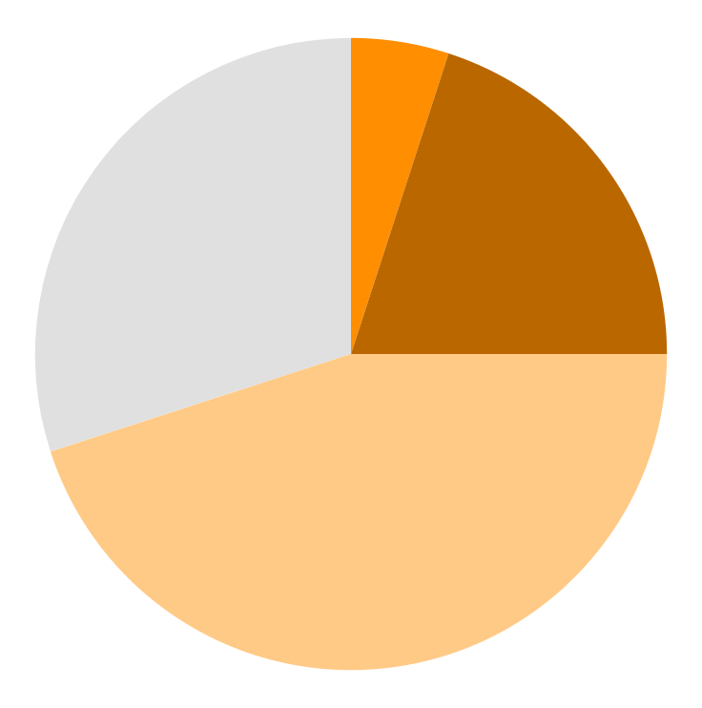
Impact of the risks
5%
20%
Saturn
Venus
Saturn is a gas giant and has several rings
Venus is the second planet from the Sun
45%
30%
Jupiter
Mars
Jupiter is the biggest planet of them all
* Follow the link in the graph to modify its data and then paste the new one here. For more info, click here
Despite being red, Mars is actually a cold place

Slide 12
Corporate strategies
Mars
Venus
Mercury
Despite being red, Mars is actually a cold place. It’s full of iron oxide dust
Venus has a beautiful name and is the second planet from the Sun
Mercury is the closest planet to the Sun and the smallest in the Solar System

Slide 13
Key drivers of the profit
 | Description | Example
The situation | You need to provide a neutral description with facts that you know your audience will agree on | Our company has been selling its products in the US for 10 years, with an annual profit growth above 10%
The complication | The complication is a desired change of the current situation | With a market share already above 40%, profit growth will be limited in the US
The question | The question that implicitly results from the complication | Should we enter the European market now?

Slide 14
Decisions: new market, new product, new company
Desirability
What is the potential demand for our product in this new market?
Profitability
Feasibility
What will be the profitability of this strategic initiative?
What is the feasibility to enter this new market?
Sweet pot

Slide 15
Strategic perspectives
Jupiter
Mars
Venus
Mercury
Jupiter is a gas giant and the biggest planet of them all
Despite being red, Mars is actually a very cold place
Venus has a beautiful name and is the second planet from the Sun
Mercury is the closest planet to the Sun and the smallest of them all

Slide 16
Awesome words

Slide 17
Strong business plan
PESTLE
Political
P
T
Technological
Replace the text with your own text
Replace the text with your own text
Economical
Legal
E
L
Replace the text with your own text
Replace the text with your own text
Social
Environmental
Replace the text with your own text
S
E
Replace the text with your own text

Slide 18
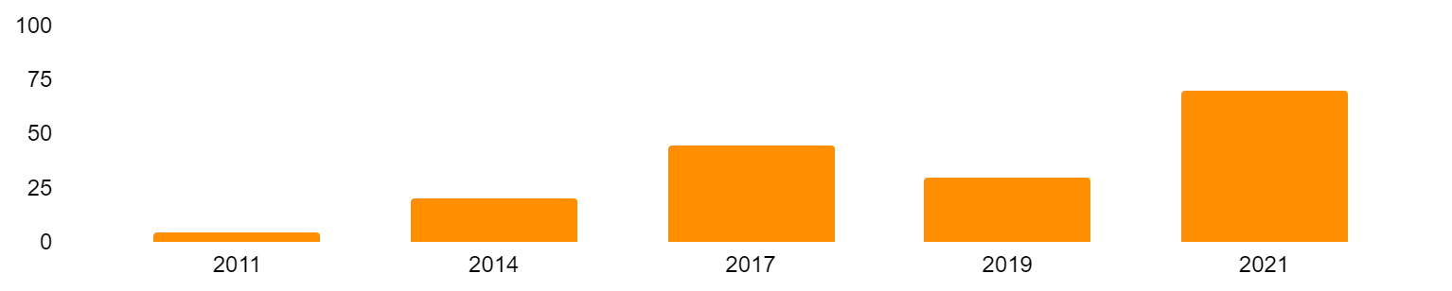
Strong business case
Project costs
$4M
Tangible benefits
$14M
Net present value
$8M
Cash flow (USD million)
Change impact
Low
Medium
High
Intangible benefits
Insert your own text here
Strategic alignment
Insert your own text here
Resources
* Follow the link in the graph to modify its data and then paste the new one here. For more info, click here
Sponsor
Sponsor name
Manager
Project manager name

Slide 19
Financial model
 | Historical results |  |  |  | Forecast period
Inc model | 2014 | 2015 | 2016 | 2017 | 2018 | 2019 | 2020 | 2021 | 2022
Balance sheet
Assets
Cash | xx | xx | xx | xx | xx | xx | xx | xx | xx
Accounts | xx | xx | xx | xx | xx | xx | xx | xx | xx
Inventory | xx | xx | xx | xx | xx | xx | xx | xx | xx
Current assets | xx | xx | xx | xx | xx | xx | xx | xx | xx
Property | xx | xx | xx | xx | xx | xx | xx | xx | xx
Goodwill | xx | xx | xx | xx | xx | xx | xx | xx | xx
Total | xx | xx | xx | xx | xx | xx | xx | xx | xx

Slide 20
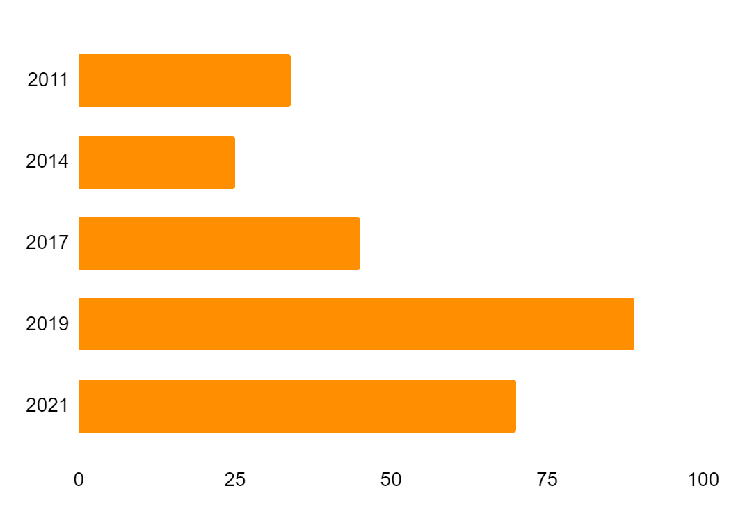
Financial model
Venus
60%
40%
Venus
Mars
Venus is the second planet from the Sun
Despite being red, Mars is a cold place
* Follow the link in the graph to modify its data and then paste the new one here. For more info, click here

Slide 21
Pricing strategy
Leading
Advanced
Standard
Basic
Level | 1 | 2 | 3 | 4
Percentage | 20% | 70% | 9% | 1%
Description | - Insert your description here - Insert your description here - Insert your description here | - Insert your description here - Insert your description here - Insert your description here | - Insert your description here - Insert your description here - Insert your description here | - Insert your description here - Insert your description here - Insert your description here

Slide 22
02
Consulting proposal
You can enter a subtitle here if you need it

Slide 23
Consulting proposal
Services
Fees
Invoices
Expenses
Materials
Terms
Mercury is the closest planet to the Sun
Venus is the second planet from the Sun
Despite being red, Mars is actually a cold place
Jupiter is the biggest planet in the Solar System
Saturn is composed of hydrogen and helium
Neptune is the farthest planet from the Sun

Slide 24
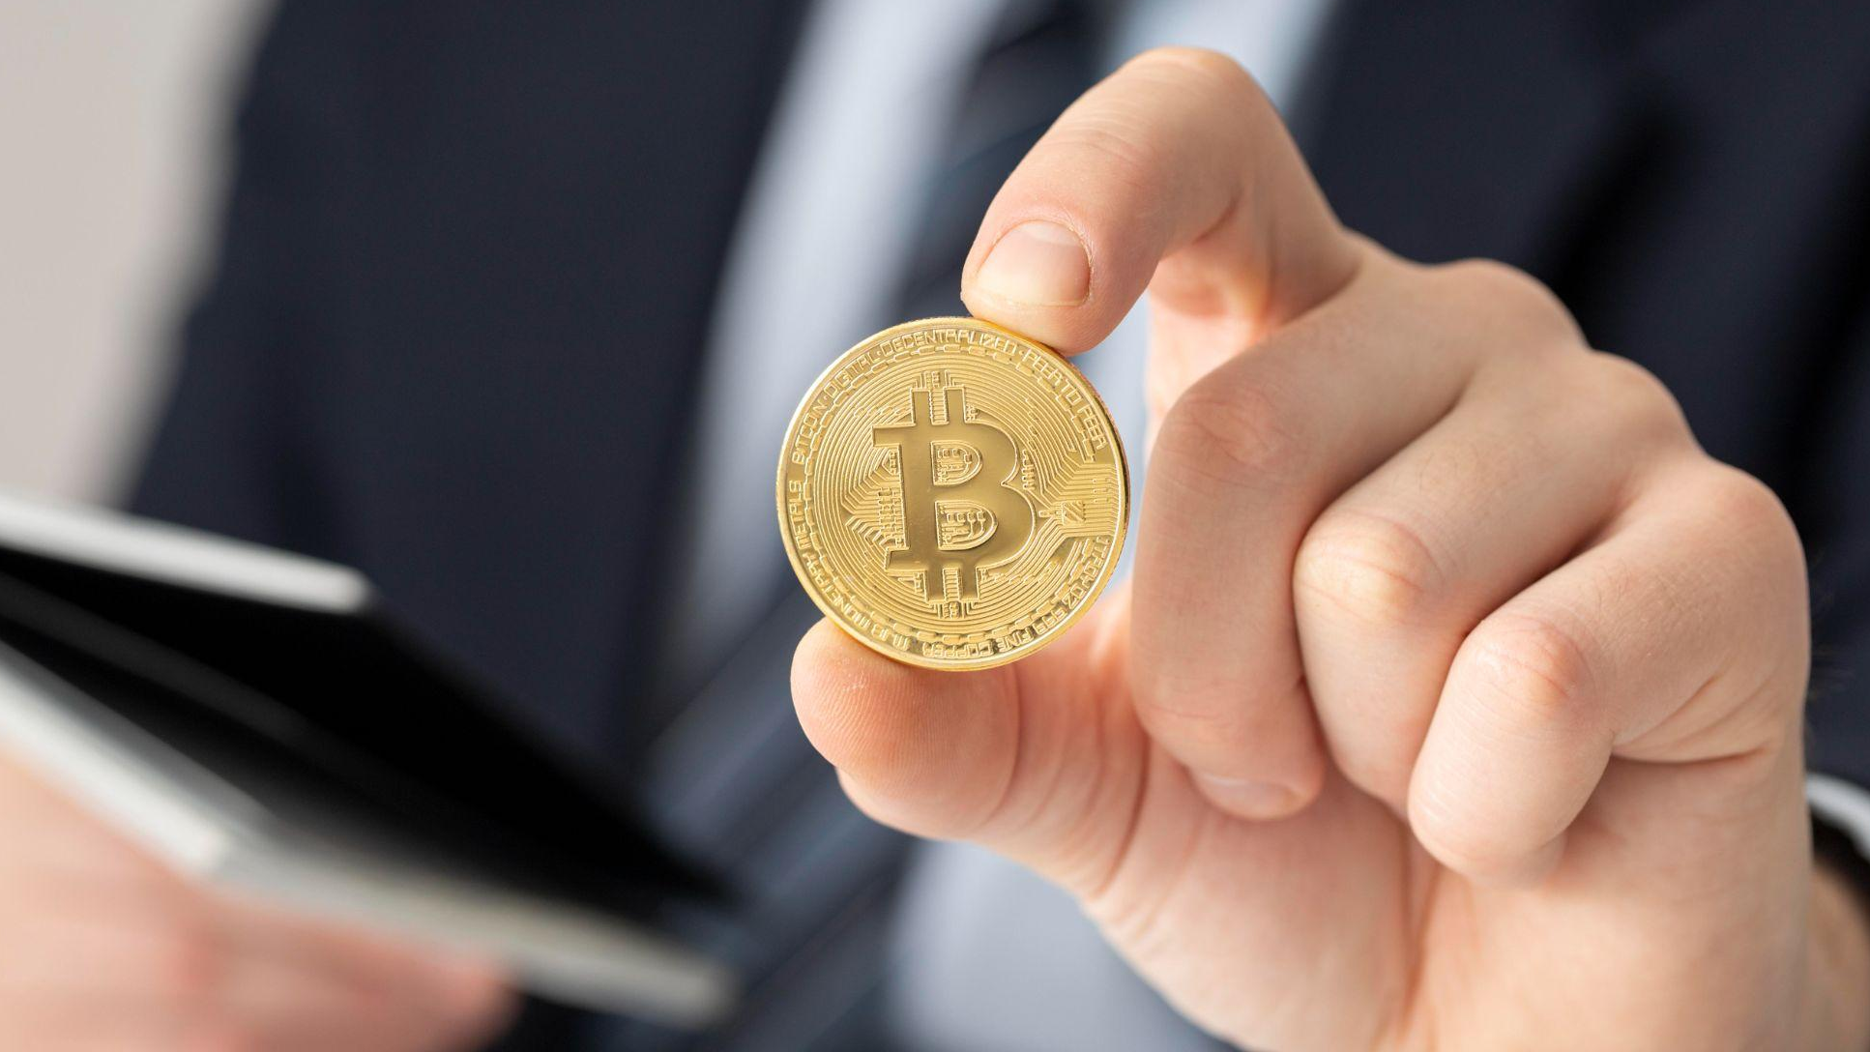
A picture is worth a thousand words

Slide 25
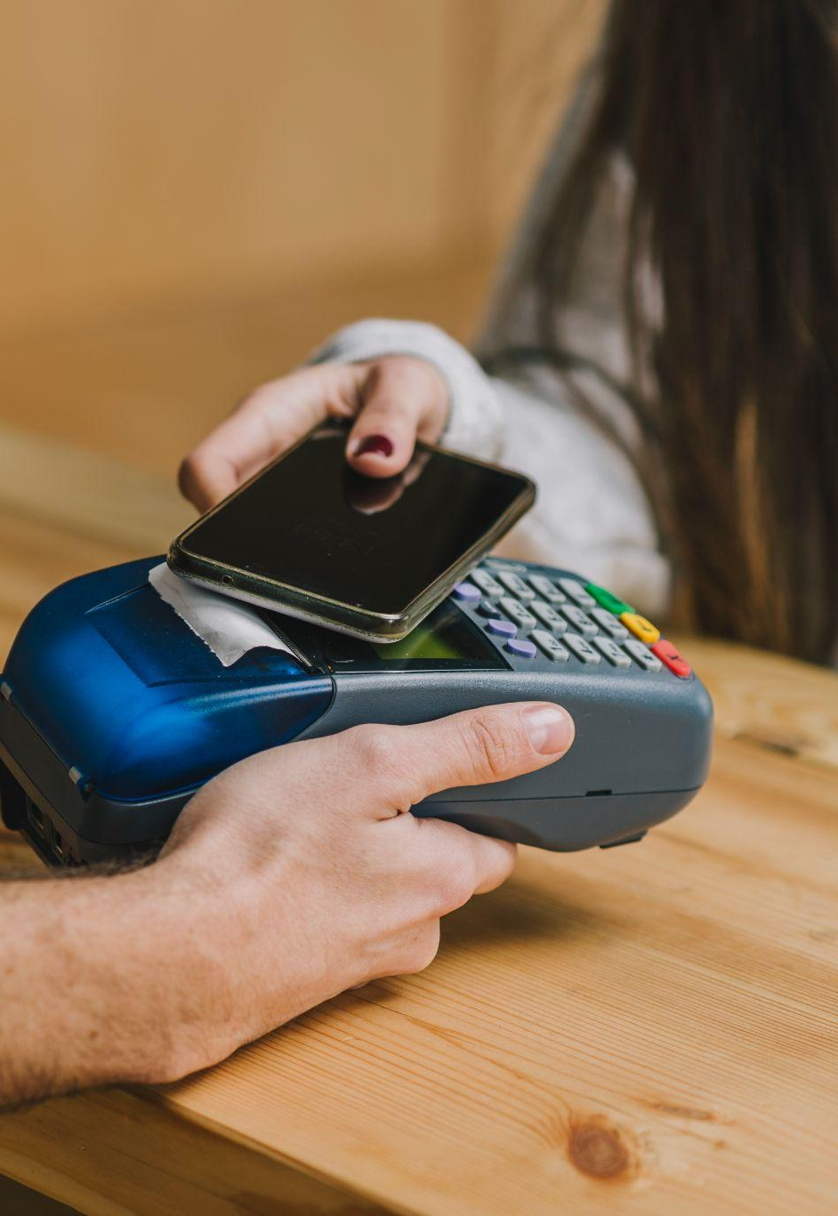
A picture always reinforces the concept
Images reveal large amounts of data, so remember: use an image instead of a long text. Your audience will appreciate it

Slide 26
Answer and supporting arguments
How can the company reduce its cost by 10%?
Reduce costs by $5 million through operational improvements
Outsource non-core
functions to save $3 Million
Simplify core functions processes to save $1 Million
Review supplier cost to save
$1 Million
Evaluate cost and service level of potential partners
Design current processes
Select and review current supplier costs
Select non-core functions
Compare current process to best-in-class benchmarks
Evaluate cost of potential alternative suppliers
Choose one partner for each function
Adopt best practices based on benchmarks
Negotiate supplier contracts/choose options

Slide 27
Initiative prioritization matrix: impact & effort
Impact
Effort
An initiative with a high impact would mean one of the following:
- The initiative needs to happen in order to achieve the desired future state
- The initiative will significantly reduce the cost or increase our revenue
The “effort” criteria is assessed based on the following concepts:
- Ease of implementation
- Time frame required
- Resources required (number of people, capital investment, etc.)

Slide 28
Prioritization matrix
Initiative
Impact
Effort
1
List all your potential initiatives
Very high
2
List all your potential initiatives
High
3
List all your potential initiatives
Low
4
List all your potential initiatives
High
5
List all your potential initiatives
Very high
6
List all your potential initiatives
High

Slide 29
03
Change management
You can enter a subtitle here if you need it

Slide 30
Change management approach
Do you know what helps you make your point clear?
Lists like this one:
They’re simple
You can organize your ideas clearly
You’ll never forget to buy milk!
And the most important thing: the audience won’t miss the point of your presentation

Slide 31
Business case
1
Mercury is the closest planet to the Sun
Business name
4
Saturn is composed of hydrogen and helium
Company
logo here
2
Jupiter is the biggest planet in the Solar System
5
Despite being red, Mars is actually a very cold place
3
Venus is the second planet from the Sun
6
Neptune is the farthest planet from the Sun
xx/xx/xx

Slide 32
Competitor comparison table
Attributes | Competitor A | Competitor B | My business
Price | $360 | $320 | $300
Quality | Low | Medium | High
Customer age | 20-40 | 18-45 | 18-50
Reputation | Bad | Average | Good
Location | Spain | Italy | USA

Slide 33

Buyer persona
Hobby 1
XX%
Mars
Mars is actually a cold place
Hobby 2
XX%
Hobby 3
XX%
Mercury
Hobby 4
XX%
Mercury is quite a small planet
Venus
Venus has a beautiful name and is the second planet from the Sun. It’s terribly hot, even hotter than Mercury, and its atmosphere is extremely poisonous. It’s the second-brightest natural object in the night sky after the Moon
XX%
Name
Anna Wilson
Age
XX years old
Occupation
Lawyer
XX%

Slide 34
Implement, track & manage progress
Manage progress
Progress
Status
Link
Venus
40%
www.yourlinkhere.com
Mars
35%
www.yourlinkhere.com
Neptune
70%
www.yourlinkhere.com
Jupiter
15%
www.yourlinkhere.com
Earth
85%
www.yourlinkhere.com
Ceres
60%
www.yourlinkhere.com

Slide 35
Change management strategy & plan
Size of the change
Extreme | Insert name of the change | Insert name of the change | Insert name of the change
High |  |  | Insert name of the change | Insert name of the change | Insert name of the change
Medium |  |  |  | Insert name of the change
Moderate
Low
 | 1 team impacted | 1 business unit | 1 division | Half company | Extreme
Complexity of the change

Slide 36
04
Implementing changes
You can enter a subtitle here if you need it

Slide 37
Sales and strategy plan
1
2
3
Implementation
Internal analysis
External analysis
5
4
Sales plan
Sales strategy

Slide 38
$489,300
Big numbers catch your audience’s attention

Slide 39
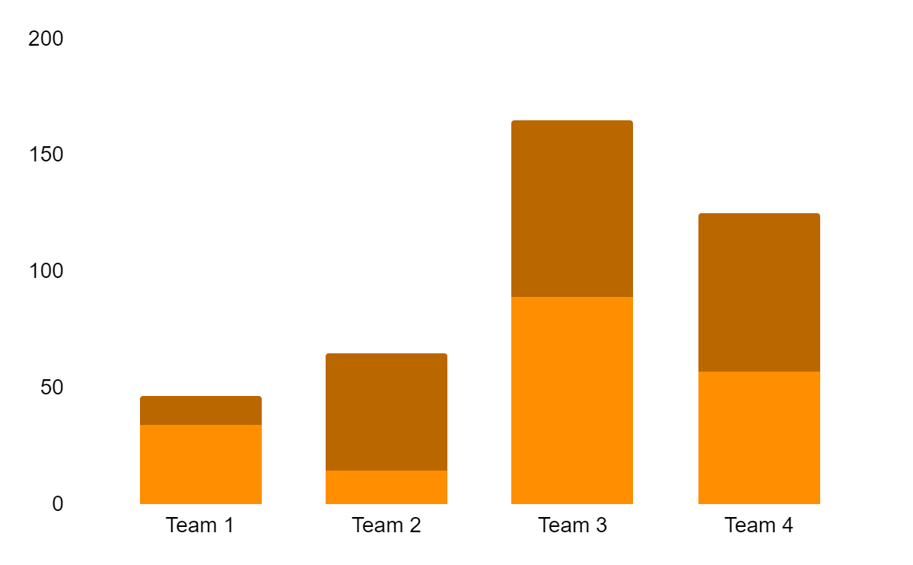
About the terms of the agreement
Venus
Venus is the second planet from the Sun
Mars
Despite being red, Mars is actually a cold place
* Follow the link in the graph to modify its data and then paste the new one here. For more info, click here

Slide 40
$20,000
$15,000
$10,000
$45,000
Mars is actually a cold planet
Venus has a beautiful name
Mercury is a very small planet
Saturn has several rings

Slide 41
Management approach
Despite being red, Mars is actually a cold place
Mercury is the smallest planet of them all
January
February
March
April
Venus is the second planet from the Sun
Saturn is a gas giant and has several rings

Slide 42
Strategic alliances
Venus
Venus is the second planet from the Sun and has very high temperatures

Slide 43
Answers and arguments
Write your question
Write your answer
Saturn
Venus
Mars
Saturn is a gas giant and has several rings. It’s composed of hydrogen and helium. It was named after the Roman god of wealth and agriculture
Venus has a beautiful name and is the second planet from the Sun. It’s terribly hot, even hotter than Mercury, and its atmosphere is poisonous
Despite being red, Mars is a cold place. It’s full of iron oxide dust, which gives the planet its reddish cast. It’s the fourth planet from the Sun

Slide 44
Waterfall management plan
Requirements
Mercury is the closest planet to the Sun
Design
Venus is the second planet from the Sun
Implementation
Jupiter is the biggest planet of them all
Verification
Saturn is composed of hydrogen and helium
Maintenance
Despite being red, Mars is actually a cold place

Slide 45
Maturity model
Basic
Standard
Advanced
Mercury is the closest planet to the Sun and the smallest in the Solar System
Venus has a beautiful name and is the second planet from the Sun
Despite being red, Mars is actually a cold place. It’s full of iron oxide dust
30%
50%
70%

Slide 46
Profitability ratios
Worst peer
Best peer
Return on sales (%)
%
%
%
Return on equity (%)
%
Return on net assets(%)
%
%
Return capital employed (%)
%
Return on funds employed (%)
%
%
Company 1
Company 2
Company 3

Slide 47
Top 10 questions of business plans
1
What is your situation?
6
Who are the key players?
2
What is your vision?
7
How to make a difference?
3
How to reach your vision?
8
What is your marketing plan?
4
What do you offer?
9
What are your economics?
5
How big is the market?
10
What do you need to start?

Slide 48

Demo software & app
You can replace the image on the screen with your own work. Just right-click on it and select “Replace image”

Slide 49


Out team
John Jimmy
Jenna Doe
You can replace the image on the screen with your own
You can replace the image on the screen with your own

Slide 50
Thanks!
Any questions?
youremail@freepik.com
+91 620 421 838
yourwebsite.com
Please keep this slide for attribution

